Slide 1


Elastic Load Balancer (ELB) & Auto Scaling
Basic Concepts

Slide 2
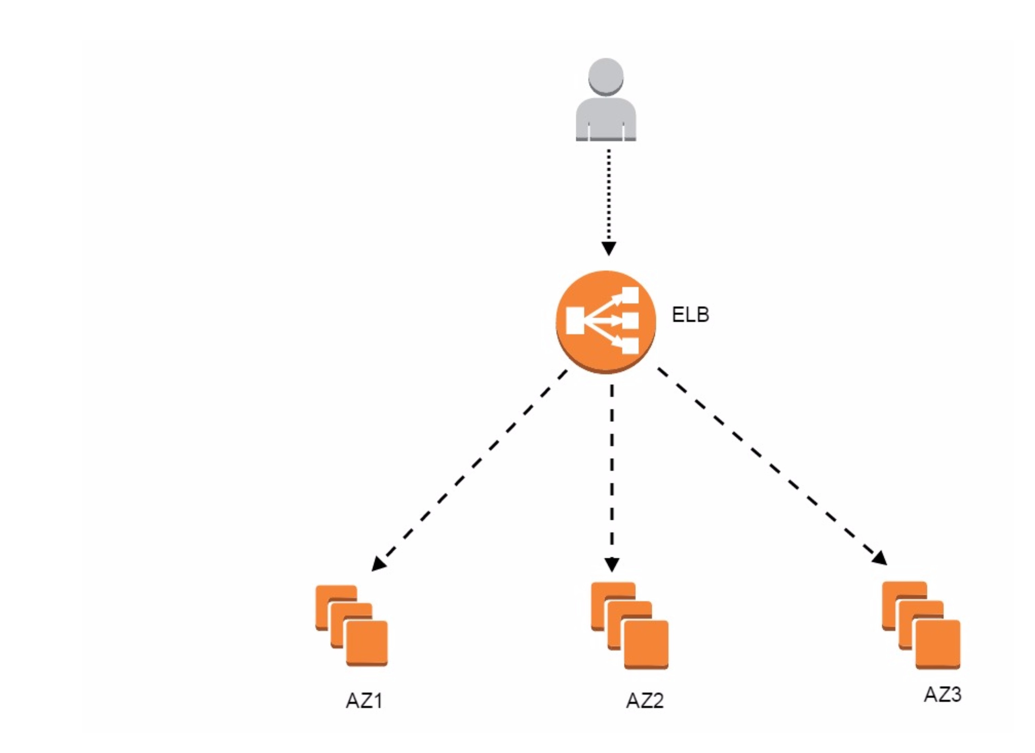
Automatically redistributes the incoming traffic to your set of EC2 instances
Load balances the incoming traffic between your EC2 instances
These EC2 instances can be collected together in a single AZ or spanned across several AZs

Slide 3
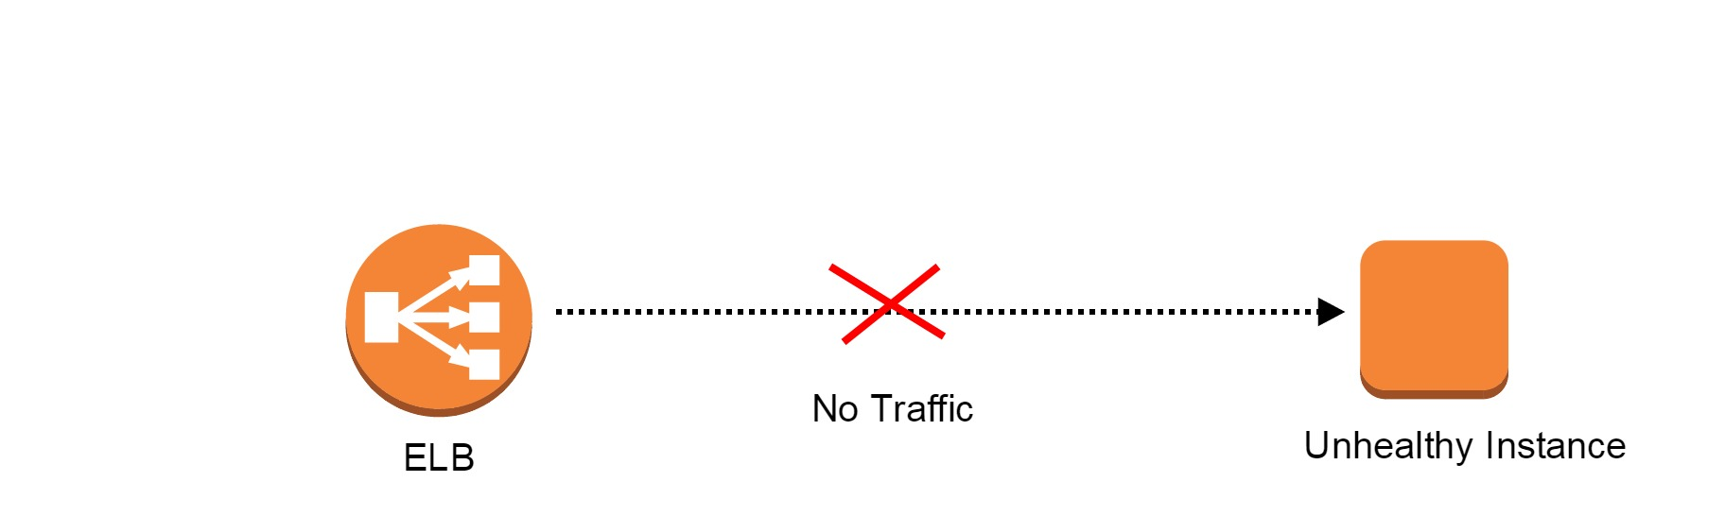
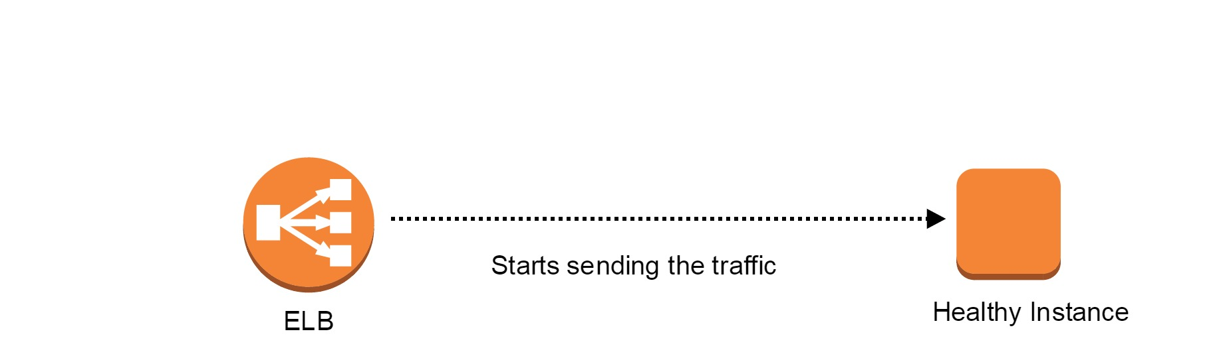

Slide 4

Traffic Manager
Distributes and manage entire web traffic efficiently
Ensures that none of a single instance is overloaded
Traffic is distributed evenly across all EC2 instances

Slide 5
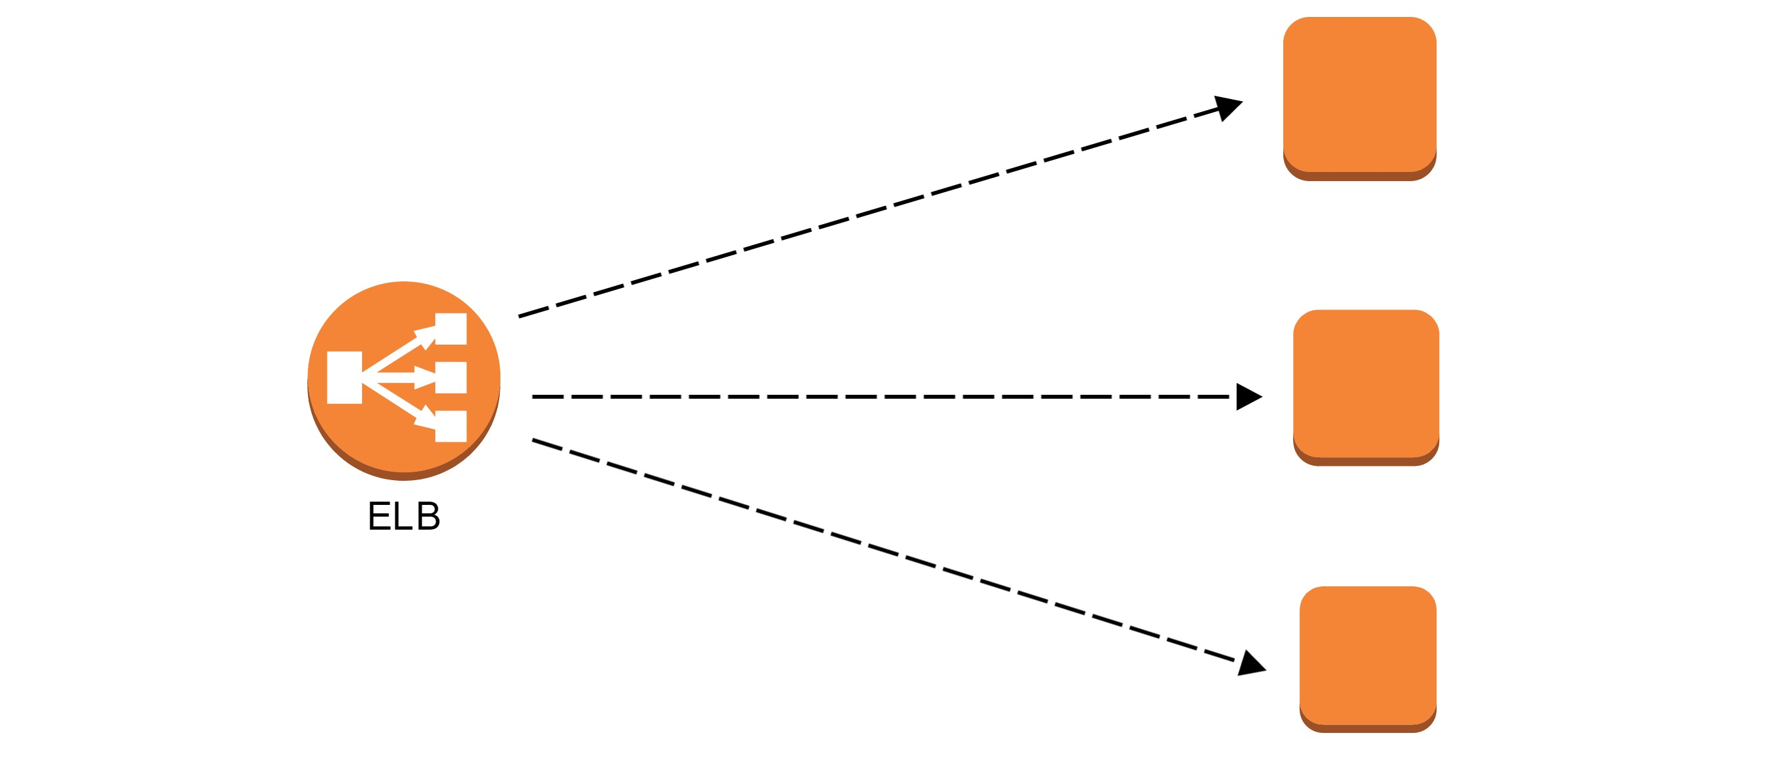
Continuous Health Monitoring
Keepalive messages are sent to EC2 instances after an interval of few seconds

Slide 6
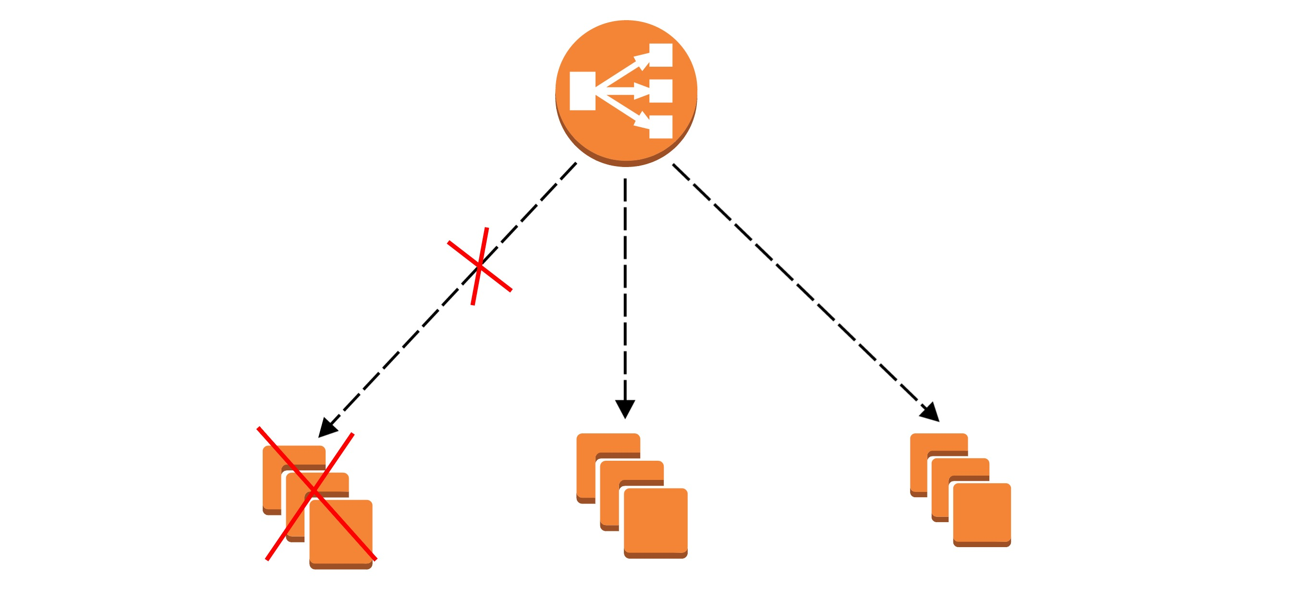
Building a Fault Tolerant Design
ELB
ELB
Region: N.California
us-west-1a
us-west-1b
us-west-1c
Provides a great level of fault tolerance and reroutes traffic in case of an instance or an entire AZ fails

Slide 7
Connection Draining
To ensure that the load balancer stops sending requests to instances that are de-registering or unhealthy, while keeping the existing connections open, use connection draining. This enables the load balancer to complete in-flight requests made to instances that are de-registering or unhealthy.
When you enable connection draining, you can specify a maximum time for the load balancer to keep connections alive before reporting the instance as de-registered. The maximum timeout value can be set between 1 and 3,600 seconds (the default is 300 seconds). When the maximum time limit is reached, the load balancer forcibly closes connections to the de-registering instance.
While in-flight requests are being served, the load balancer reports the state of a de-registering instance as InService: Instance deregistration currently in progress. When the de-registering instance is finished serving all in-flight requests, or when the maximum timeout limit is reached, the load balancer reports the instance state as OutOfService: Instance is not currently registered with the LoadBalancer.
If an instance becomes unhealthy, the load balancer reports the instance state as OutOfService. If there are in-flight requests made to the unhealthy instance, they are completed. The maximum timeout limit does not apply to connections to unhealthy instances.
If your instances are part of an Auto Scaling group and connection draining is enabled for your load balancer, Auto Scaling waits for the in-flight requests to complete, or for the maximum timeout to expire, before terminating instances due to a scaling event or health check replacement.

Slide 8
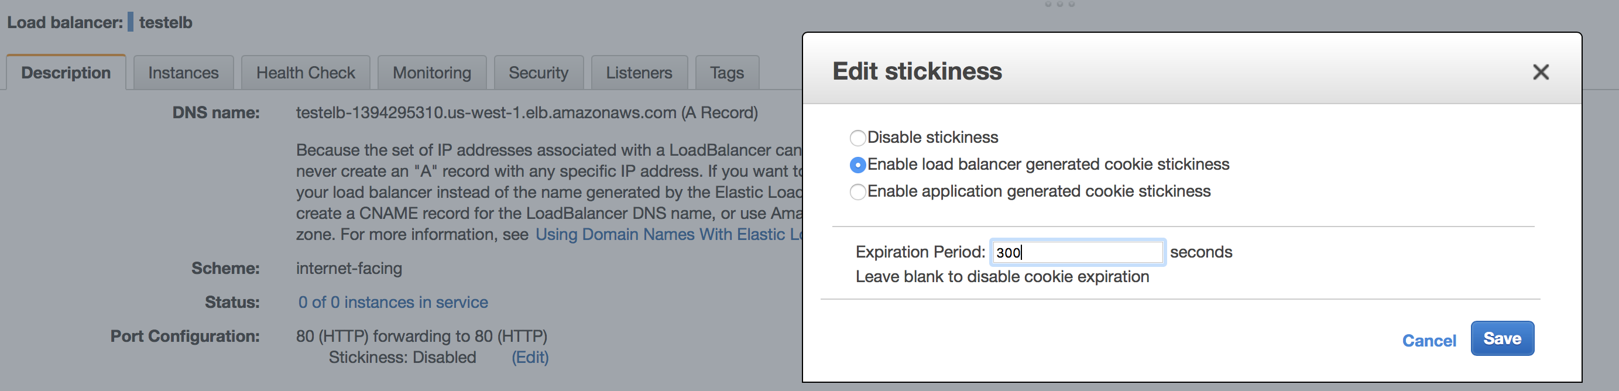
Stickiness
By default, a load balancer routes each request independently to the registered instance with the smallest load. However, you can use the sticky session feature (also known as session affinity), which enables the load balancer to bind a user's session to a specific instance. This ensures that all requests from the user during the session are sent to the same instance.
The key to managing sticky sessions is to determine how long your load balancer should consistently route the user's request to the same instance. If your application has its own session cookie, then you can configure Elastic Load Balancing so that the session cookie follows the duration specified by the application's session cookie.
If your application does not have its own session cookie, then you can configure Elastic Load Balancing to create a session cookie by specifying your own stickiness duration.
Elastic Load Balancing creates a cookie, named AWSELB, that is used to map the session to the instance.

Slide 9
Supports four types of traffic
HTTP
HTTPS (Secure HTTP)
TCP
SSL (Secure TCP)
Pricing
“Pay as you go model”
Time duration
Each gigabyte of data that surpasses ELB

Slide 10

Types of Load Balancers
Internet facing (Public)
Internal (Private)
Internet facing load balancers are exposed to the internet
Internal load balancers are not exposed to the internet and are purely intended for carrying out the internal operations inside your VPC

Slide 11
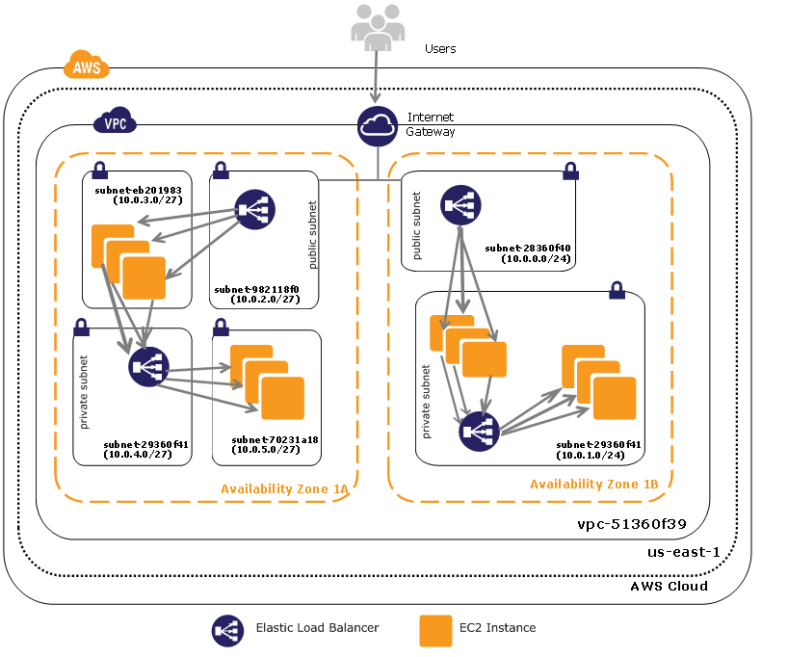

Slide 12
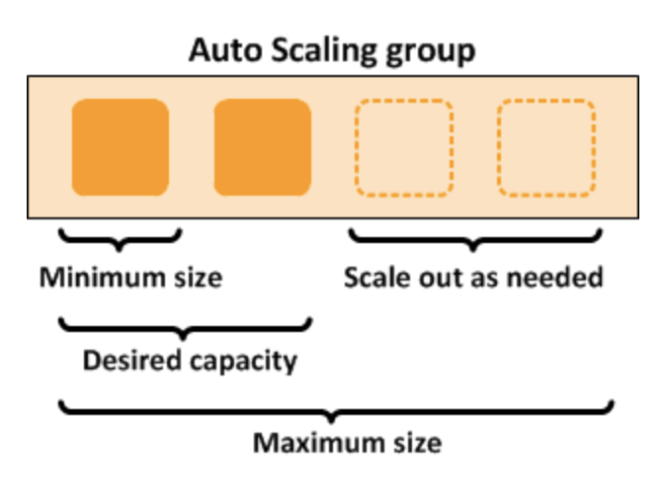
What is Auto Scaling ?
Auto Scaling helps you ensure that you have the correct number of Amazon EC2 instances available to handle the load for your application.
You create collections of EC2 instances, called Auto Scaling groups. You can specify the minimum number of instances in each Auto Scaling group, and Auto Scaling ensures that your group never goes below this size. You can specify the maximum number of instances in each Auto Scaling group, and Auto Scaling ensures that your group never goes above this size.
If you specify the desired capacity, either when you create the group or at any time thereafter, Auto Scaling ensures that your group has this many instances.
If you specify scaling policies, then Auto Scaling can launch or terminate instances as demand on your application increases or decreases.

Slide 13



Components of Auto Scaling
Your EC2 instances are organized into groups so that they can be treated as a logical unit for the purposes of scaling and management. When you create a group, you can specify its minimum, maximum, and, desired number of EC2 instances.
Groups
Your group uses a launch configuration as a template for its EC2 instances. When you create a launch configuration, you can specify information such as the AMI ID, instance type, key pair, security groups, and block device mapping for your instances.
Launch Configurations
A scaling plan tells Auto Scaling when and how to scale. For example, you can base a scaling plan on the occurrence of specified conditions (dynamic scaling) or on a schedule.
Scaling Plan

Slide 14
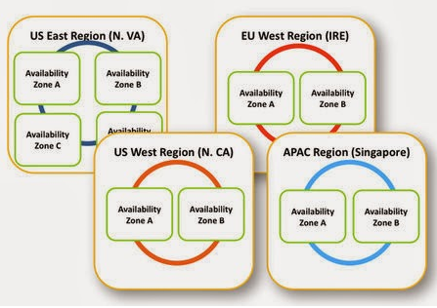
Benefits of Auto Scaling
Makes your architecture more fault tolerant
Makes your application more highly available
Ensures that there is a right capacity of instances running across your infrastructure

Slide 15
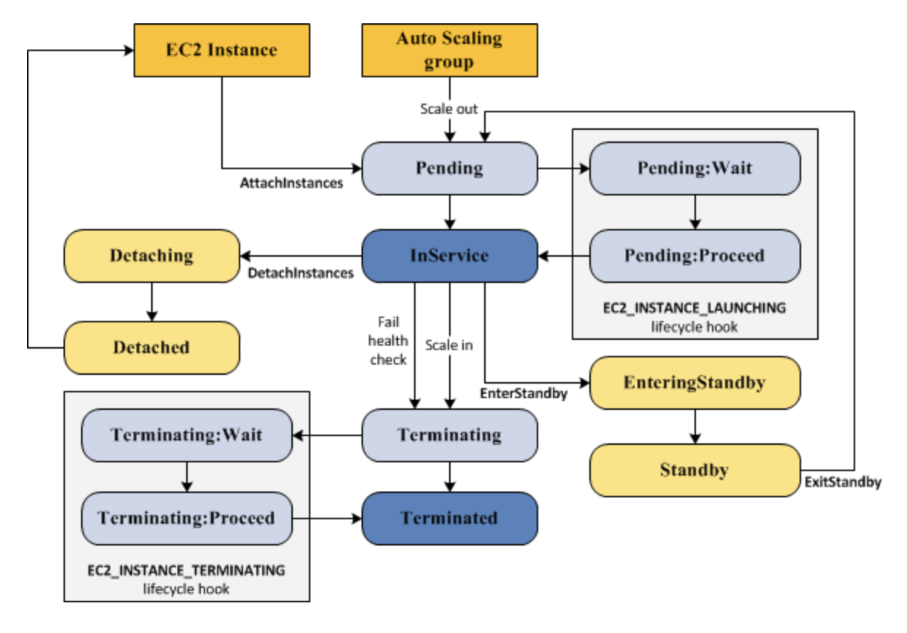
Auto Scaling Lifecycle
The EC2 instances in an Auto Scaling group have a path, or lifecycle, that differs from that of other EC2 instances. The lifecycle starts when the Auto Scaling group launches an instance and puts it into service. The lifecycle ends when you terminate the instance, or the Auto Scaling group takes the instance out of service and terminates it.

Slide 16
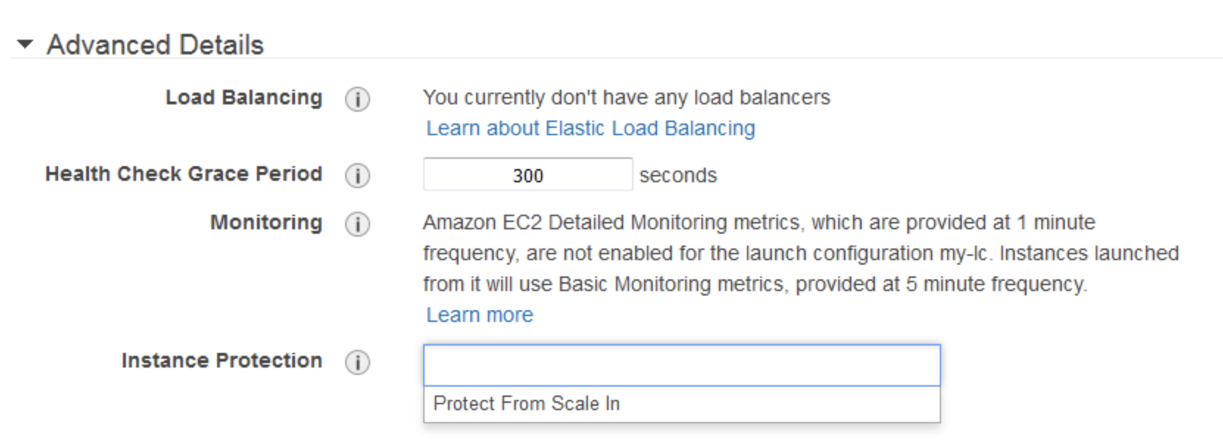
Instance Protection
You can enable instance protection when you create an Auto Scaling group. By default, instance protection is disabled.
To enable instance protection using the console
When you create the Auto Scaling group, on the Configure Auto Scaling group details page, under Advanced Details, select the Protect From Scale In option from Instance Protection.

Slide 17
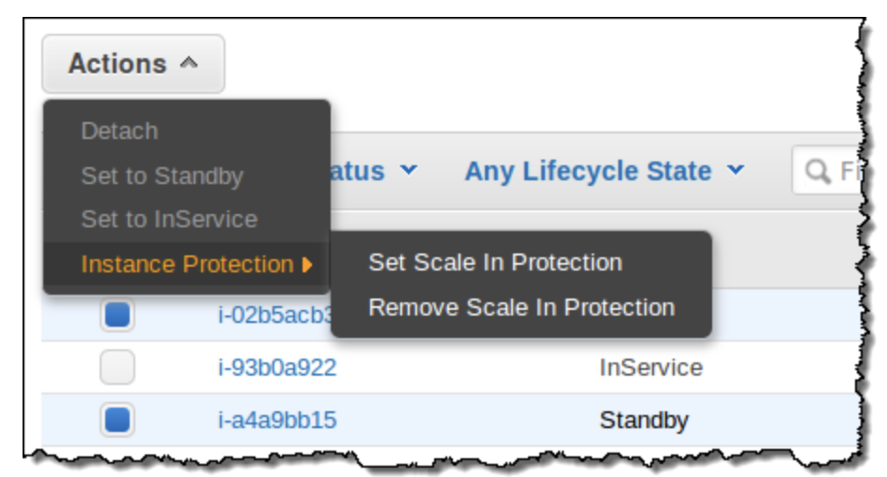
Also, you can have an additional control over the instances that are eligible to be terminated when one of your Auto Scaling groups processes a scale in action.
You might want to do this for several reasons. First, an instance might be handling a long-running work task, perhaps pulled from an SQS queue. Protecting the instance from termination will avoid wasted work. Second, the instance might serve a special purpose within the group. It could be the master node of a Hadoop cluster, or a “canary” that flags the entire group of instances as up and running.
Protecting Instances from Termination During Scale In
You can protect instances from termination by simply selecting them in the Auto Scaling Console and then choosing Instance Protection from the Actions menu:

Slide 18
Termination Policies
With each Auto Scaling group, you control when Auto Scaling adds instances (referred to as scaling out) or remove instances (referred to as scaling in) from your network architecture. You can scale the size of your group manually by attaching and detaching instances, or you can automate the process through the use of a scaling policy.
When you have Auto Scaling automatically scale in, you must decide which instances Auto Scaling should terminate first. You can configure this through the use of a termination policy.
Default Termination Policy
The default termination policy is designed to help ensure that your network architecture spans Availability Zones evenly. When using the default termination policy, Auto Scaling selects an instance to terminate as follows:
Auto Scaling determines whether there are instances in multiple Availability Zones. If so, it selects the Availability Zone with the most instances and at least one instance that is not protected from scale in. If there is more than one Availability Zone with this number of instances, Auto Scaling selects the Availability Zone with the instances that use the oldest launch configuration.
Auto Scaling determines which unprotected instances in the selected Availability Zone use the oldest launch configuration. If there is one such instance, it terminates it.
If there are multiple instances that use the oldest launch configuration, Auto Scaling determines which unprotected instances are closest to the next billing hour. (This helps you maximize the use of your EC2 instances while minimizing the number of hours you are billed for Amazon EC2 usage.) If there is one such instance, Auto Scaling terminates it.
If there is more than one unprotected instance closest to the next billing hour, Auto Scaling selects one of these instances at random.

Slide 19
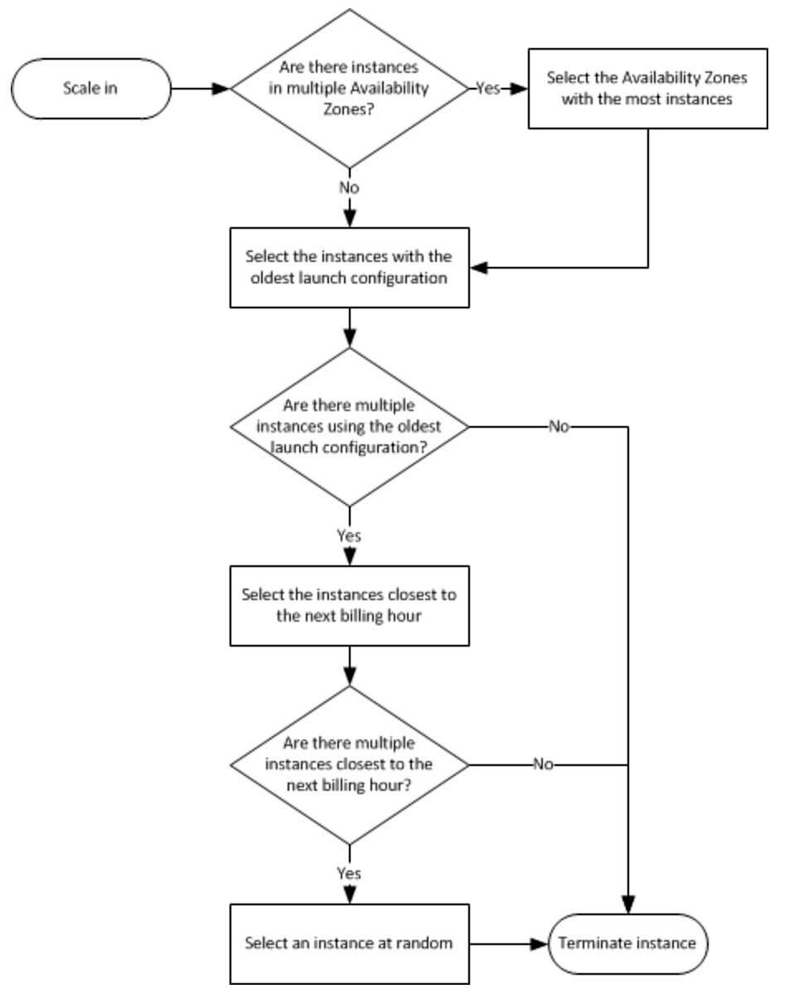

Slide 20
Customizing the Termination Policy
The default termination policy assigned to an Auto Scaling group is typically sufficient for most situations. However, you have the option of replacing the default policy with a customized one.
Auto Scaling currently supports the following custom termination policies:
OldestInstance: Auto Scaling terminates the oldest instance in the group. This option is useful when you're upgrading the instances in the Auto Scaling group to a new EC2 instance type, so you can gradually replace instances of the old type with instances of the new type.
NewestInstance: Auto Scaling terminates the newest instance in the group. This policy is useful when you're testing a new launch configuration but don't want to keep it in production.
OldestLaunchConfiguration: Auto Scaling terminates instances that have the oldest launch configuration. This policy is useful when you're updating a group and phasing out the instances from a previous configuration.
ClosestToNextInstanceHour: Auto Scaling terminates instances that are closest to the next billing hour. This policy helps you maximize the use of your instances and manage costs.
Default. Auto Scaling uses its default termination policy. This policy is useful when you have more than one scaling policy associated with the group.

Slide 21
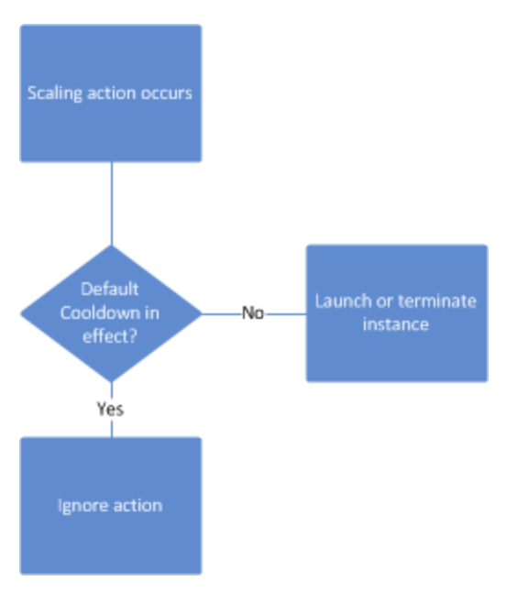
Auto Scaling Cooldowns
The Auto Scaling cooldown period is a configurable setting for your Auto Scaling group that helps to ensure that Auto Scaling doesn't launch or terminate additional instances before the previous scaling activity takes effect. After the Auto Scaling group dynamically scales using a simple scaling policy, Auto Scaling waits for the cooldown period to complete before resuming scaling activities. When you manually scale your Auto Scaling group, the default is not to wait for the cooldown period, but you can override the default and honor the cooldown period. Note that if an instance becomes unhealthy, Auto Scaling does not wait for the cooldown period to complete before replacing the unhealthy instance.
Default Cooldowns
The default cooldown period is applied when you create your Auto Scaling group. Its default value is 300 seconds.

Slide 22
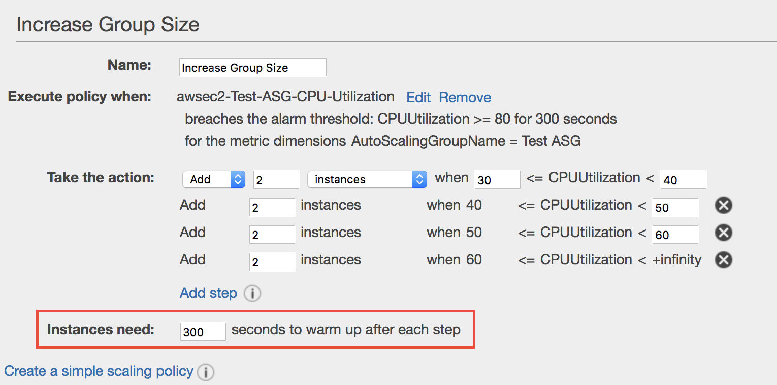
Instance Warmup Period
With step scaling policies, you can specify the number of seconds that it takes for a newly launched instance to warm up. Until its specified warm-up time has expired, an instance is not counted toward the aggregated metrics of the Auto Scaling group.
While scaling out, Auto Scaling does not consider instances that are warming up as part of the current capacity of the group. Therefore, multiple alarm breaches that fall in the range of the same step adjustment result in a single scaling activity. This ensures that we don't add more instances than you need.
While scaling in, Auto Scaling considers instances that are terminating as part of the current capacity of the group. Therefore, we won't remove more instances from the Auto Scaling group than necessary.
A scale in activity can't start while a scale out activity is in progress.

Slide 23
Configuring Simple & Step Scale-out and Scale-in policies
When you create a scaling policy, you must specify its policy type. The policy type determines how the scaling action is performed. Auto Scaling supports the following policy types:
Simple scaling—Increase or decrease the current capacity of the group based on a single scaling adjustment.
Step scaling—Increase or decrease the current capacity of the group based on a set of scaling adjustments, known as step adjustments, that vary based on the size of the alarm breach.
Simple Scaling Policies
After a scaling activity is started, the policy must wait for the scaling activity or health check replacement to complete and the cooldown period to expire before it can respond to additional alarms. Cooldown periods help to prevent Auto Scaling from initiating additional scaling activities before the effects of previous activities are visible. You can use the default cooldown period associated with your Auto Scaling group, or you can override the default by specifying a cooldown period for your policy.
Step Scaling Policies
After a scaling activity is started, the policy continues to respond to additional alarms, even while a scaling activity or health check replacement is in progress. Therefore, all alarms that are breached are evaluated by Auto Scaling as it receives the alarm messages. If you are creating a policy to scale out, you can specify the estimated warm-up time that it will take for a newly launched instance to be ready to contribute to the aggregated metrics.

